Slide 1

Bike Safety through Social Gamification
Team Herald
& Prof. Sung Ju Lee

Slide 2
Problem Statement
Detect
unsafe biking habits
and promote long-term change
through social gamification
Notes:
In the past 2 months, our group has worked on developing an application detects unsafe biking habits and promote long-term change through social gamification.

Slide 3
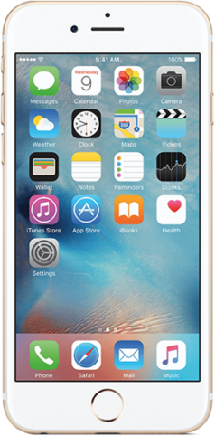
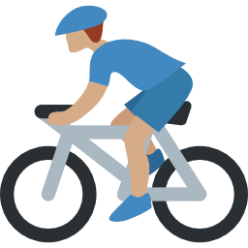
Existing Works Don’t Do Enough
BikeMate(TsingHua University)
Detect and Alert
BikeTastic(UCLA)
Map Out Safe Routes
Detection
Notes:
Despite bike safety being a long-standing problem, we found that existing works stopped at providing information and simple alerts. BikeMate, for example, only detected a few unsafe biking habits and alerted the users, while BikeTastic provided information about safe bike routes.
But this not enough to convince users to change unsafe habits that they have developed throughout the years.
BikeMate: Only detect stand pedalling, lane weaving, wrong lane (and then only alerts) Tsinghua University
BikeTastic: Collects and visualizes data regarding biking route safety (route roughness and noisiness) UCLA

Slide 4

Self-Motivating, Long-Term Solution
Detection
Social Gamification
Notes:
Our project takes this further, and offers a self-motivating and long-term solution with the addition of social gamification features.

Slide 5
Phone Use
Detect
6 Aspects
Speeding
Biking on a Wrong Lane
Speeding at Intersections
Listening to Music
Biking in Bad Weather
Notes:
In terms of detection, through the survey we conducted for our midterm presentation, we managed to analyse the top reasons for bike accidents on campus, and decided to focus on detecting 6 unsafe biking habits that we could reliably detect using smartphones.

Slide 6

Gamification
Design Method
Notes:
And as we mentioned earlier on, we decided to add social gamification features to incentivize bad baikers to change their behaviors. We were especially excited about this approach because (1) it hasn’t been done and (2) we found that KAIST has a unique social atmosphere which is heavily based around tight-knit friendship groups. By combining this finding with the 3 most popular game features amongst KAIST students we surveyed, we designed our app.

Slide 7

Gamification
Design Method
Tight-knit friendship groups
Notes:
in the surveys and interviews we conducted, we found that many bad bikers lacked the incentive to change their behaviors. So we decided to motivate users through a socially gamified approach. We were especially excited about this approach because (1) it hasn’t been done and (2) we found that social interactions in KAIST were heavily based around tight-knit friendship groups. By combining this with the 3 most popular game features amongst KAIST students we surveyed, we designed our app.

Slide 8



Gamification
Design Method
Tight-knit friendship groups
Competitions
Social
Interactions
Achievements
Notes:
in the surveys and interviews we conducted, we found that many bad bikers lacked the incentive to change their behaviors. So we decided to motivate users through a socially gamified approach. We were especially excited about this approach because (1) it hasn’t been done and (2) we found that social interactions in KAIST were heavily based around tight-knit friendship groups. By combining this finding with the 3 most popular game features amongst KAIST students we surveyed, we designed our app.

Slide 9

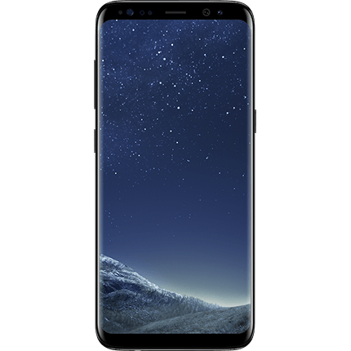
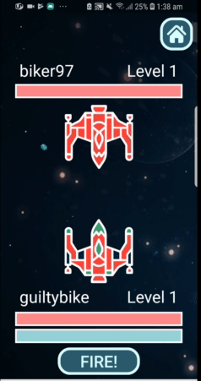
Invite Friends
Notes:
In our app, we designed a space battle game which would have users invite and fight their friends using their own spaceships.(as you can see here)
Every time a user biked, depending on the number of dangerous aspects detected, he or she would be rewarded with a proportionate amount of energy, which could then be used to shoot at their friends’ battleships, to eventually destroy them. To discourage unsafe habits further, we made it so that consecutive unsafe bike rides would decrease the damage you could do with the same energy.
By pitting them against their friends, we found that users were much more engaged and invested in the app compared to battling random users. We were also able to promote much more competition between friends.

Slide 10

Invite Friends
Notes:
To bring everything together, we designed a space battle game which would have users invite and fight their friends using their own spaceships.(as you can see here)
Every time a user biked, depending on the number of dangerous aspects detected, he or she would be rewarded with a proportionate amount of energy, which could then be used to shoot at their friends’ battleships, to eventually destroy them. To discourage unsafe habits further, we made it so that consecutive unsafe bike rides would decrease the damage you could do with the same energy.
By pitting them against their friends, we found that users were much more engaged and invested in the app compared to battling random users. We were also able to promote much more competition between friends.

Slide 11

Invite Friends
Notes:
To bring everything together, we designed a space battle game which would have users invite and fight their friends using their own spaceships.(as you can see here)
Every time a user biked, depending on the number of dangerous aspects detected, he or she would be rewarded with a proportionate amount of energy, which could then be used to shoot at their friends’ battleships, to eventually destroy them. To discourage unsafe habits further, we made it so that consecutive unsafe bike rides would decrease the damage you could do with the same energy.
By pitting them against their friends, we found that users were much more engaged and invested in the app compared to battling random users. We were also able to promote much more competition between friends.

Slide 12

Invite Friends
Notes:
To bring everything together, we designed a space battle game which would have users invite and fight their friends using their own spaceships.(as you can see here)
Every time a user biked, depending on the number of dangerous aspects detected, he or she would be rewarded with a proportionate amount of energy, which could then be used to shoot at their friends’ battleships, to eventually destroy them. To discourage unsafe habits further, we made it so that consecutive unsafe bike rides would decrease the damage you could do with the same energy.
By pitting them against their friends, we found that users were much more engaged and invested in the app compared to battling random users. We were also able to promote much more competition between friends.

Slide 13

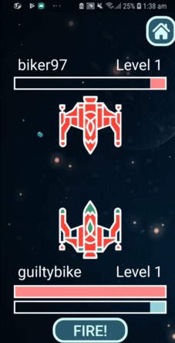
Invite Friends
Destroy Friends
Notes:
To bring everything together, we designed a space battle game which would have users invite and fight their friends using their own spaceships.(as you can see here)
Every time a user biked, depending on the number of dangerous aspects detected, he or she would be rewarded with a proportionate amount of energy, which could then be used to shoot at their friends’ battleships, to eventually destroy them. By winning these battles, users can level up and win achievements.
By pitting users against their friends, we found that users became very competitive and tried to beat their friends by collecting more energy through safer bike rides.

Slide 14
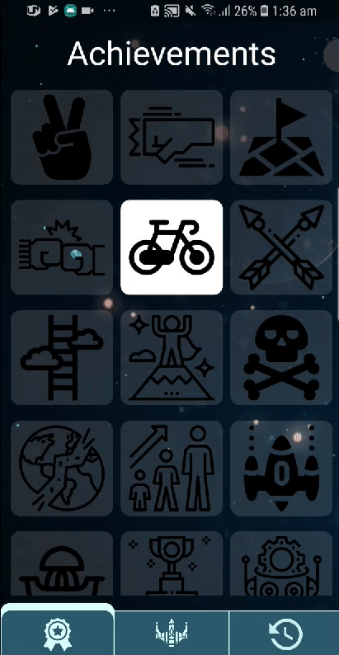
Earn Achievements
Provide long-term engagement and challenge
Notes:
In addition, we created many safety-related achievements to provide sustained incentives and a challenge for users in the long run. alongside our main game.
One achievement was called the “Smooth Riding” achievement which was given if a user had one perfectly safe biking session or the “Better safe than sorry” achievement if they have logged 5 perfectly safe biking sessions.

Slide 15
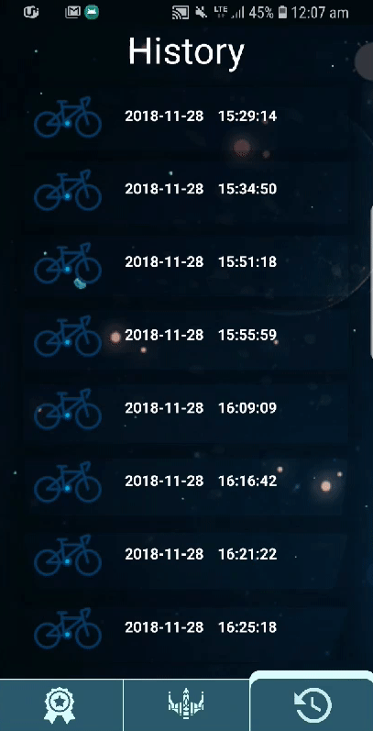

Receive Feedback
Provide history of bike sessions for future improvements
Notes:
And, lastly, the history screen of the app logs all the previous bike sessions of a user, and gives feedback in terms of the 6 unsafe biking habits we detect. By referring to this, users are able to become more aware of how unsafe they have been, and correct their biking habits in the future.

Slide 16
10 trials for each detection category to test detection
Biking vs Walking
Phone Use
Speeding
Biking on a Wrong Lane
Speeding at Intersections
Listening to Music
Biking in Bad Weather
Notes:
And through the survey we conducted back in our midterm presentation, we managed to analyse the top reasons for bike accidents on campus, and decided to focus on detecting 6 unsafe biking habits that we could realistically detect using smartphones.
Our app detects phone use, speeding, biking on a wrong lane, speeding at intersections, listening to music, biking in bad weather such as rain and snow.

Slide 17

Can detect with 90% accuracy biking versus walking

Slide 18





Can detect with 100% accuracy phone use music bad weather speeding

Slide 19
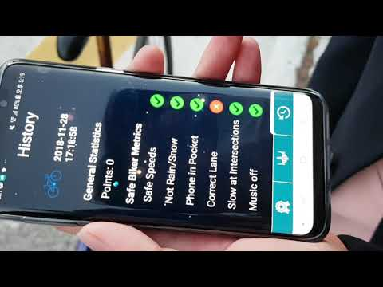
Can detect biking in a wrong lane with 60% accuracy
Can detect speeding at an intersection with 80% accuracy

Slide 20

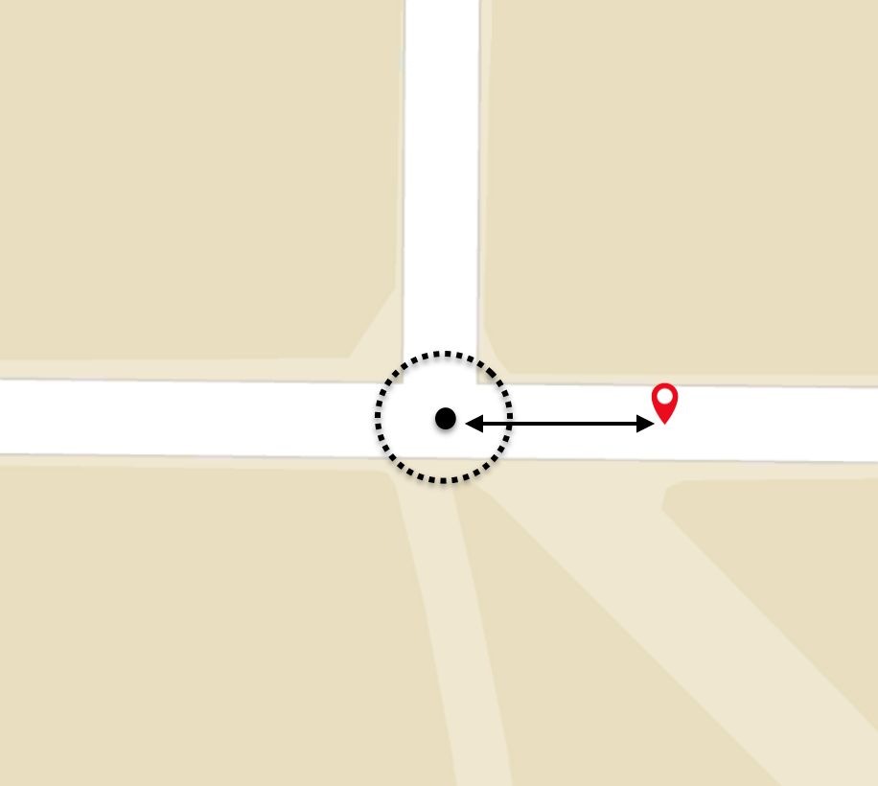


}

Slide 21
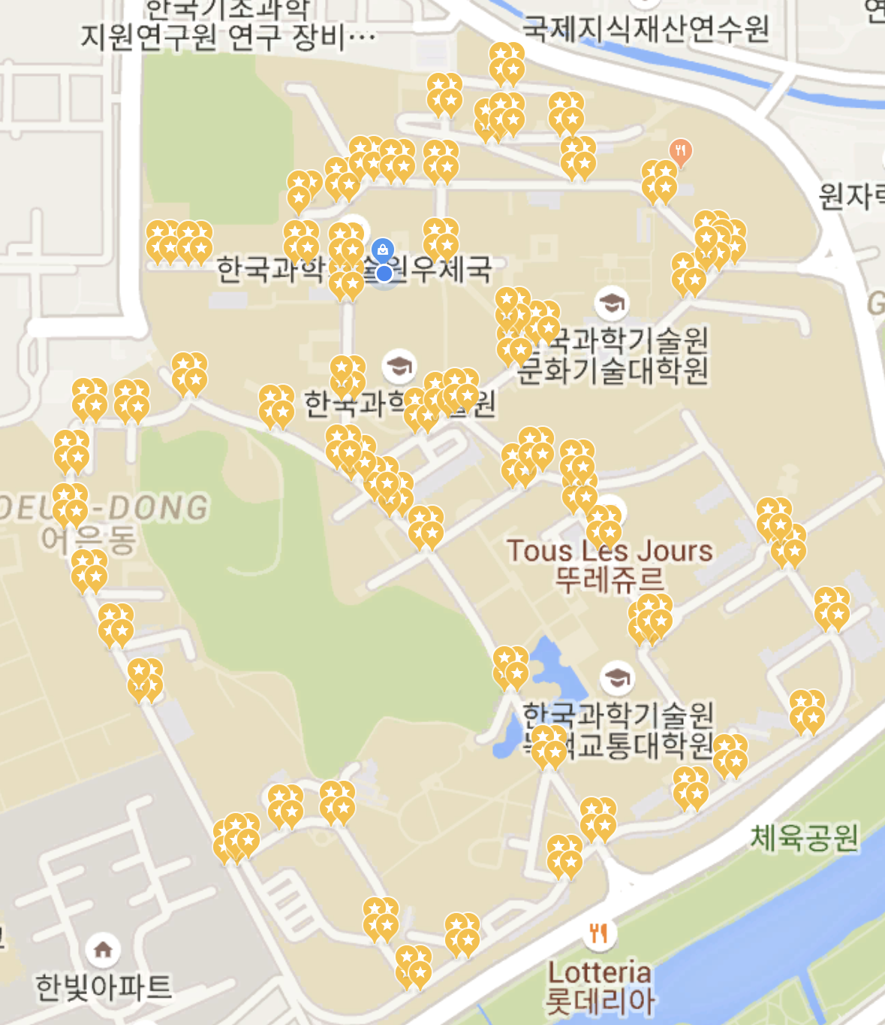
Mapping points for wrong lane and intersections

Slide 22

User Study
Pre-Interview
x 6
Log for Each Session - Date and Time - Duration - Distance - Type of Dangerous Aspects Detected (out of 6)
Four Day Study Period
Unsafe Bikers
Post-Interview
Notes:
Now that we had built our application, we need to evaluate how effective it was at making unsafe bikers safer
So for this we conducted a four day long user study with six unsafe bikers we recruited from our midterm survey and interviews
To understand these bikers better, we also conducted pre and post interviews, and we also logged, for each of their biking sessions, the date time, duration, distance and types of penalties they infringed during the session

Slide 23
Total Sessions Logged: 65
Data Processing
Number of Dangerous Aspects Detected During Biking Session
3
Biking Sessions of User 1
Notes:
To evaluate this log data, we had to do some minor data processing.
From each biking session of each user, we could count the number of different dangerous aspect detected during that biking session
Because each user had a different number of biking sessions, to understand a users change in behavior throughout the study

Slide 24
Total Sessions Logged: 65
Data Processing
First Quarter Average = 2
3
1
2
Biking Sessions of User 1
Notes:
We calculated the average of these values for the first quarter of the biking sessions

Slide 25
Total Sessions Logged: 65
Data Processing
First Quarter Average = 2
Last Quarter Average = 0.67
3
1
2
1
0
1
Biking Sessions of User 1
Notes:
And the last quarter
And then we compared these values

Slide 26
Overall Decrease in Dangerous Aspects Detected
5
/6 participants
Notes:
We found that out of our 6 participants, 5 (almost all of them) showed an overall decrease in dangerous behavior
Also

Slide 27
Average Change Among Users in Number of Dangerous Aspects Detected per Biking Session
-17%
Notes:
We found that the average decrease among our participants on the number of dangerous aspects detected per biking session was of around 17%
Even though our study period was short, we can see from our data that our application had a considerable and positive effect on the bike safety of our participants
Through our interviews, we discovered that this positive change was due to three main reasons

Slide 28
(1) Energy System Provided Incentives
Pre
User 2: “Sometimes I wear headphones. [..] I feel like I might get into an accident [because of this], but I don’t really care that much.”
Notes:
First, our energy system motivated change. Our participant user 2 mentioned in his preinterview that he would normally wear headphones and listen to music while biking
although he knew that this could lead to an accident, he didnt really care

Slide 29
(1) Energy System Provided Incentives
Pre
Post
User 2: “Sometimes I wear headphones. [..] I feel like I might get into an accident [because of this], but I don’t really care that much.”
User 2: “Sometimes I listen to music while biking, but I realized that that cuts off my [energy] so sometimes I do not listen to music anymore.”
Notes:
However, in his postinterview he explained that because he saw that our application granted him less energy for listening to music while biking
And because of this he didn't have enough energy to fire at his friend
He decided to try to not listen to music while biking as much

Slide 30
(2) Detection and Feedback
Educated Bikers
User 3: “I realized that I speed at points where I thought it was a normal speed, and that counted as a failure in the app and I tried being more conscious about that after that.”
Notes:
Secondly, we saw that our detection and consequent feedback educated the bikers on what safe and unsafe biking behaviors were
Our participant User 3 detailed in his post interview that he realized that the app was detecting speeding and penalized him for it when he thought he biked at a normal speed Because of this feedback, he became more conscious about the speed at which he would bike and consequently biked more slowly throughout the rest of the study

Slide 31
(3) Friendships Promoted Application Use
User 5: “I think if it wasn’t connected to my friends, I wouldn’t use [the application] because it wouldn’t be really fun.”
Notes:
Lastly, we found that a lot of the participants were encouraged to frequently use the application because of social interactions
User 5 commented that, if he was placed into battles against random people instead of friends, he would not have been motivated to use the application because it would simply not be fun
This shows that our focus on social gamification prompted users to engage with our application more
Overall, even though our study was smaller scale and not that long term, our results show promising signs that a socially gamified approach Can have a positive effect in the behavior of unsafe bikers

Slide 32
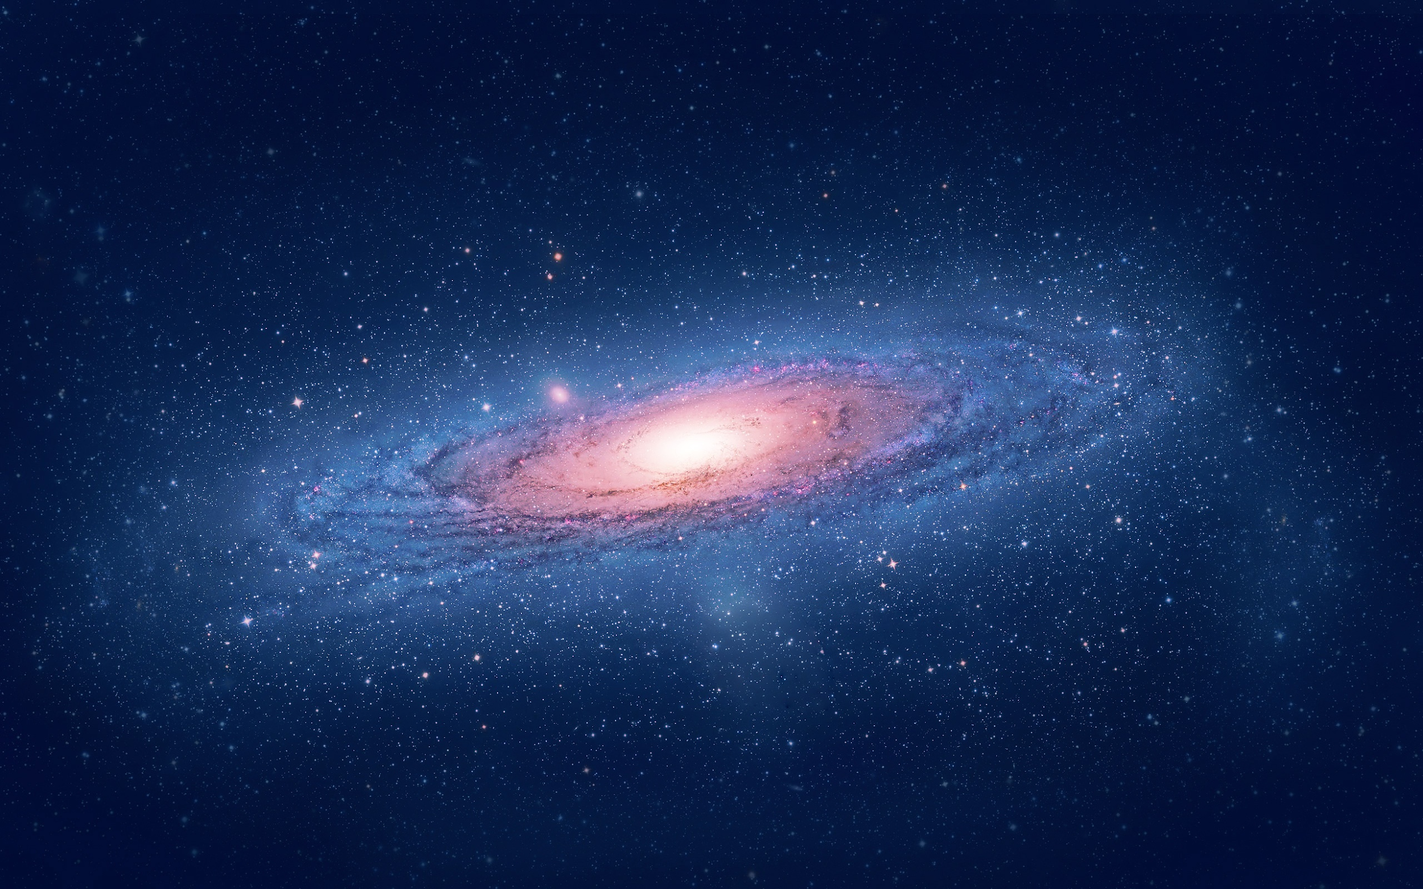
We’re here

Slide 33
1. Improve game interactivity and features

Slide 34
1. Improve game interactivity and features
2. Improve detection more dangerous aspects and more accuracy

Slide 35
1. Improve game interactivity and features
3. Larger-scale user study longer period and more users
2. Improve detection more dangerous aspects and more accuracy

Slide 36
BIKE SAFE, HAVE FUN

Slide 37
To Infinity and Beyond...

Slide 38
Tech Behind Detection

Slide 39



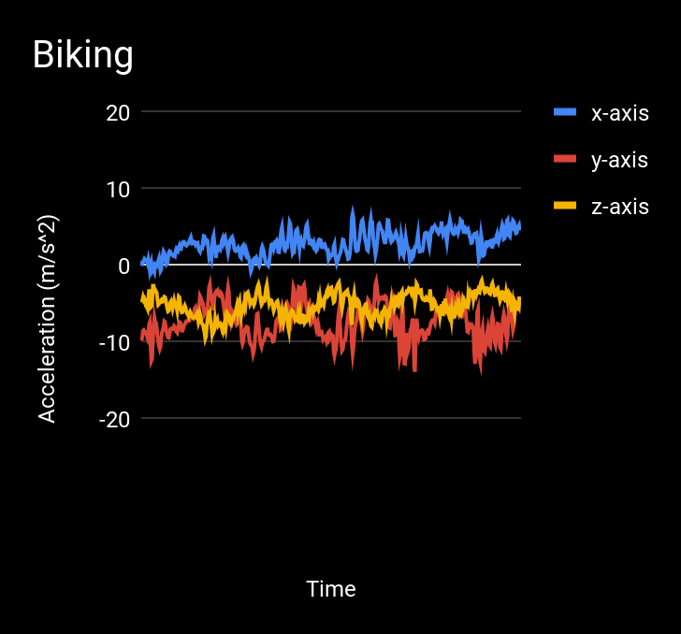
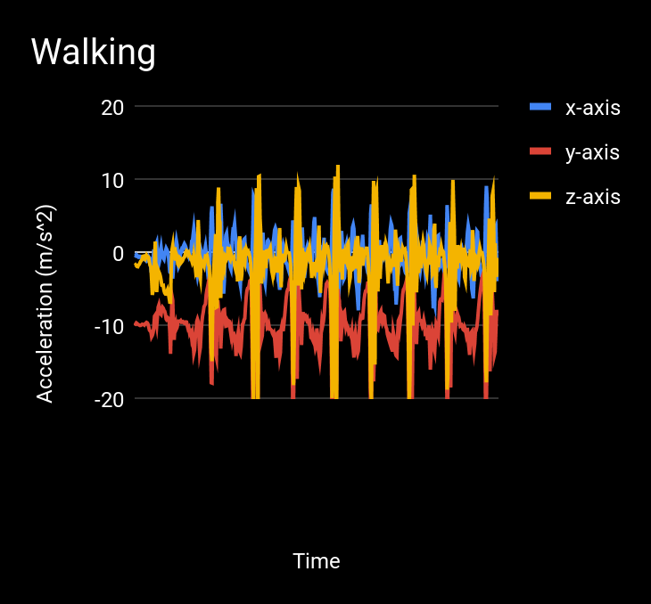
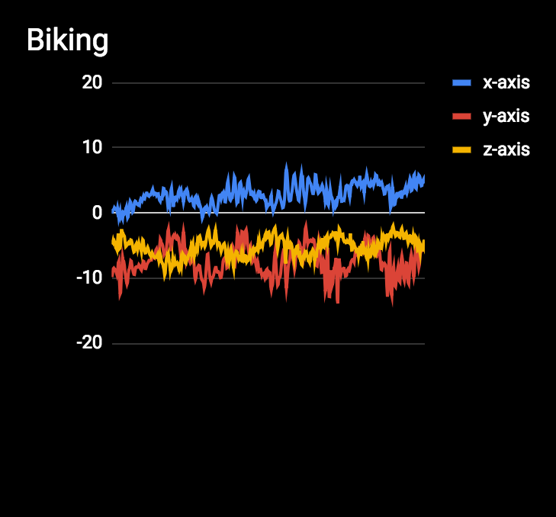
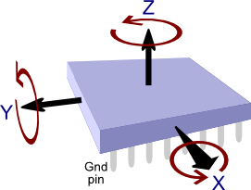
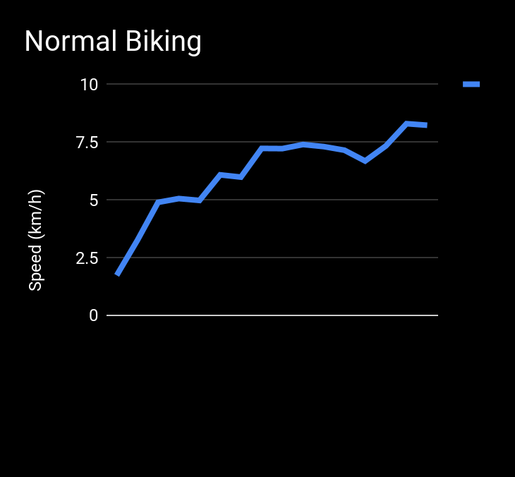
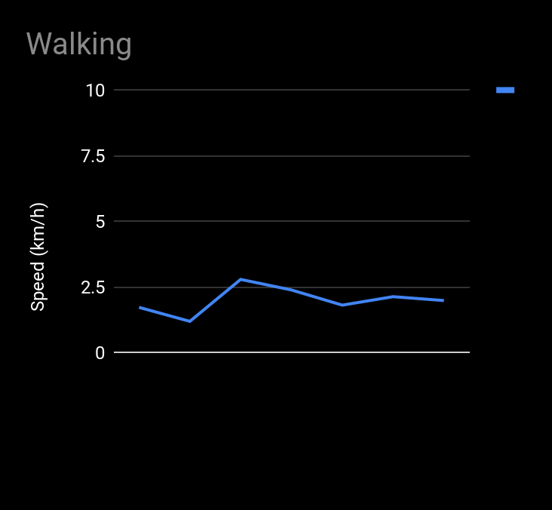
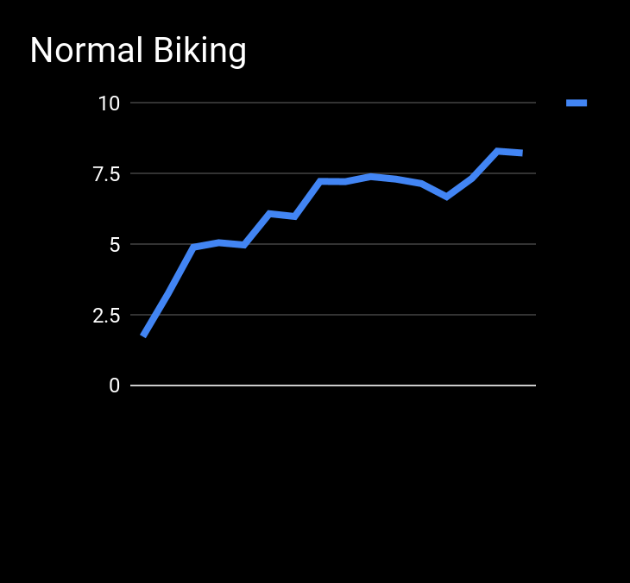

Biking Detection
Homemade sensor algorithm
Google Transition API
versus

Slide 40
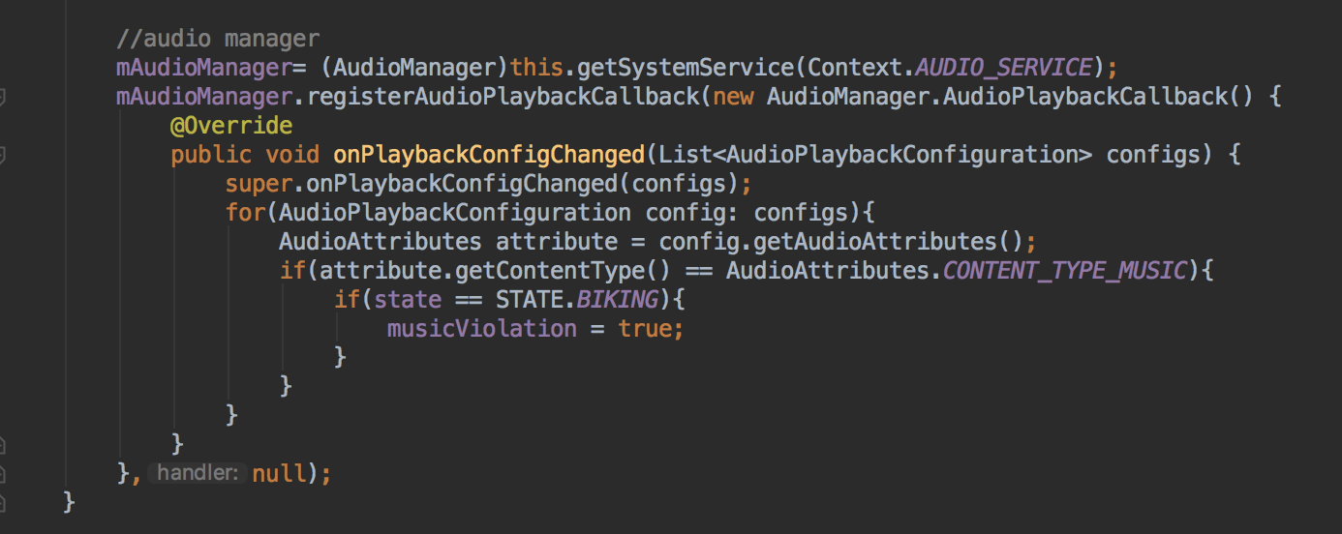
Phone Use and Music
Used Android libraries to listen for changes in state of phone use/music playing;
detect whether changes happened while biking

Slide 41

• Problem (30%)
• Problem definition (10%): Is the refined final problem well-defined?
• Design goals & rationale (20%): Are the major design goals (specifications) and rationale for the selected approach clear?
• Progress (50%)
• Solution (20%): Does the final product improve any existing solutions?
• Implementation & functionality (30%): Does it provide a live demo? Does the implementation realize the initial specifications?
• Presentation (20%)
• Delivery (10%): Does the presentation well-organized? Does it flow well? Is the story clear?
• Visual aids (10%): Are the slides readable? Does the presentation use visual aids and examples effectively?

Slide 42
Require no user input/interaction while biking & phone in pocket
How individual users turn/speed instead of potential accidents
Problem Statement
Passively detect personal biking habits and motivate bike safety by providing post-biking feedback with a socially gamified approach
No real-time alerts; feedback will be given after they are done biking
Effective method of Incentivisation

Slide 43
User Study
Duration, distance, date/time and penalties received
6 Unsafe Bikers
Day 1
Day 2
Day 3
Day 4
Pre-Interview
Post-Interview

Slide 44


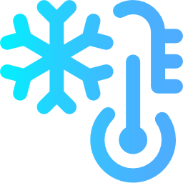
Bad testing conditions exacerbated the short testing period

Slide 45

Bad testing conditions exacerbated the short testing period

Slide 46
Pre-Interviews
Q On a scale of 1 to 5, how safely do you think you bike?

Slide 47

On a scale of 1 to 5, how safely do you think you bike?
Notes:
As you can see they’re pretty unsafe
And we could see this in the data as well

Slide 48
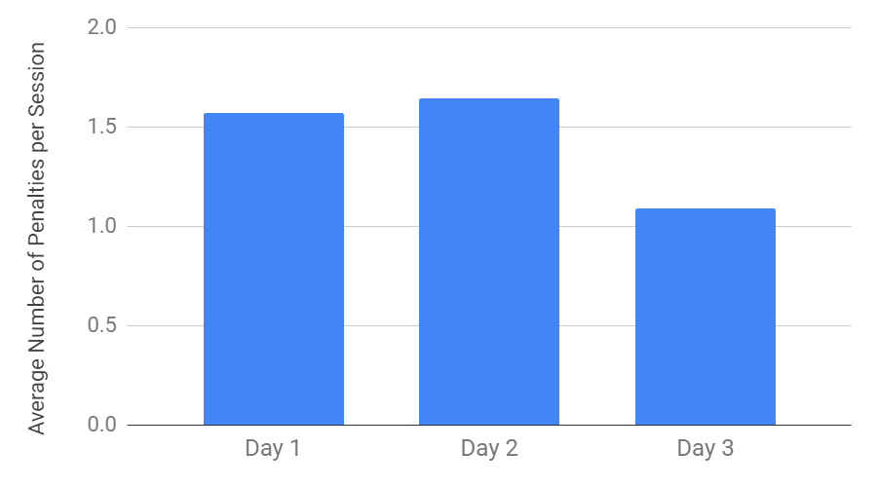
Average Number of Penalties for Each Day
“I realized that the app was giving me no energy because I was speeding, but I thought it was a normal speed”
Notes:
From data calculated
From the graph see average of around 1.5 penalties for each session on day 1 and 2
But as users started understanding the application better and what constituted unsafe biking behaviors We saw a decrease in the average number of penalties
For example one user explained in his post interview, the app was penalizing him for what he previously thought was a safe speed

Slide 49
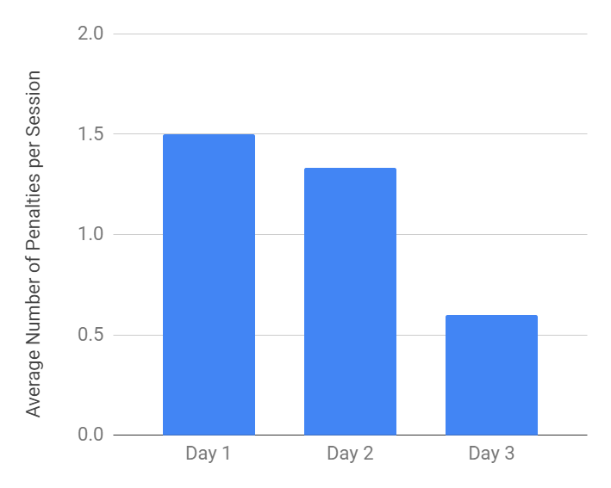
Safest Biker
Notes:
We also calcualted the changes for individual bikers
Our safest biker saw a steady and substantial decrease as he used the application

Slide 50
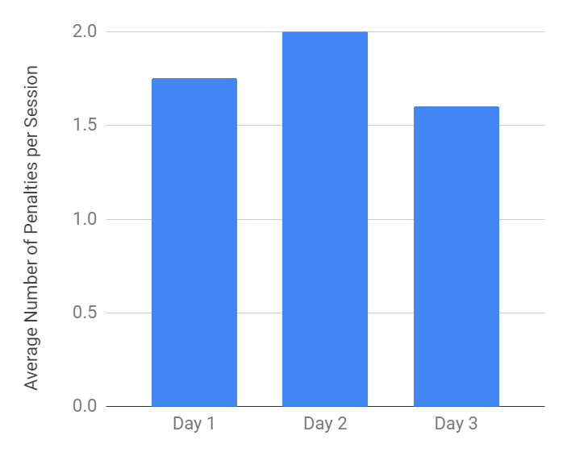
Safest Biker
Most Dangerous Biker
Notes:
While our most dangerous biker barely changed his behavior throughout the study period The incentives provided by the application were not enough to break his habit of listening to music and using his phone while biking

Slide 51
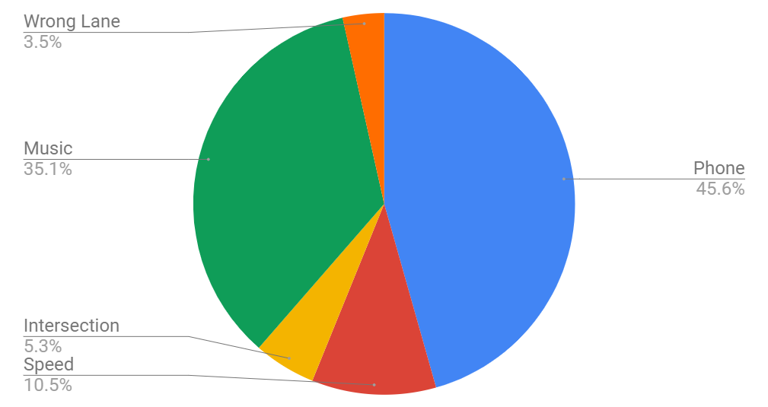
Proportion of Penalties Received

Slide 52
Proportion of Penalties Received

Slide 53
Post-Interviews
Q What aspects of the application worked and/or did not work for you?
Notes:
So to understand the flaws and merits of our application better
We asked our participants in the post interview, what aspects of the application worked or did not work for them

Slide 54
What aspects of the application worked and/or did not work for you?
Notes:
And as you can see, the comments were mixed
From the post interviews and our user study, we have identified limitations and areas for improvement

Slide 55
Thank You!
Any questions?

Slide 57
Skit
Sees friend using app, is like woah what is that app
Friend explains app: energy from safe biking, firing, win battles and get achievements
And then friend “you shit biker ill beat yo ass”
“Fuck ill beat yo ass”
So then he installed the app and then they battled for a week

Slide 58
Skit: Narrator
But he realized he was getting no energy because he biked unsafely
< For each detection part >
First he was biking too quickly (Show clips cut from the long continuous detection video, reenactment?)
Our app detects this through < blah blah blah >
< Back to Skit >
And then he lost

Slide 59
Back to Skit
(N) Because he was dangerous he lost the battle
Friend laughing at him “oh you so shit”
(N) So after that he decided to be safer
(N) And this led to him winning the next battle and winning achievements (because of survey)
(N) As you can see from the skit, social gamification (battling friends, achievements, levels) can encourage people to bike more safely [Survey data]
“And now i am safe biker thanks to the app”
And thats our app and we carried out a study to see how well our hypothesis is

Slide 60
Additional Slides

Slide 61
Battery Concern
0% app used
Google API says it does not use a lot of battery

Slide 62
Continuous Videos of Safe and Unsafe Detections

Slide 63
Demo Sequence
Wrong lane(lotteria-->taxi stand)
Correct lane(taxi stand-->lotteria)
Speeding at Intersection(lotteria-->N4 intersection)
Come back to lotteria
Circle around and do things like

Slide 64
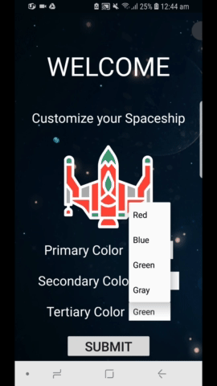
Notes:
SpaceShip Battles where you’re given a spaceship and
~ explain whole flow.
We found several features users wanted through our surveys…
And here, we have achievements,

